Slide 1
ALLUSIONS!
Quiz Day: Tuesday, May 19

Slide 2
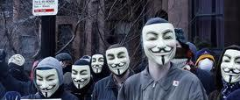
Write this definition at the top of your packet!
Allusion: a reference to a mythological, literary, or historical person, place, or thing.

Slide 3
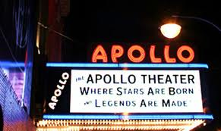
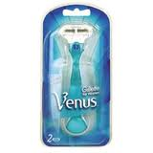
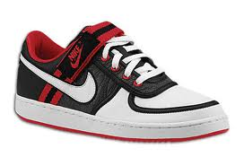
Examples
Venus was the goddess of beauty, which is appropriate for the Venus razor brand and Venus Swimwear.
Ajax - Greek warrior in the Trojan War, who "cleaned up" in battle; popular household cleanser.
Apollo - God of music; Apollo Theater is a famous music hall in New York City.
Midas - King with the golden touch, who transformed all he touched to gold; a famous muffler and brake chain of service stations.
Nike - Winged goddess of Victory, who can run and fly at great speeds

Slide 4
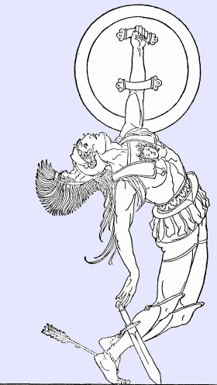
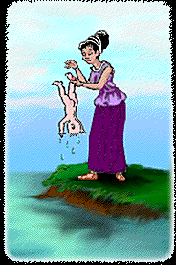
Achilles’ Heel
Refers to a person’s area of particular vulnerability
When Achilles was a baby, his mother dipped him in the River Styx because the waters gave immortality to humans. His mother held him by the heel, so that was the only place on his body not touched by water. From then on, Achilles’ heel was his one area of vulnerability. Eventually, Achilles was killed in the Trojan War when a poisoned arrow struck his heel.
Example:
Her inability to resist rich desserts was her Achilles’ heel, keeping her from losing the ten pounds she wanted to lose.

Slide 5
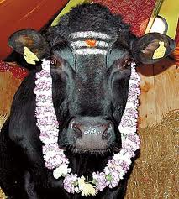
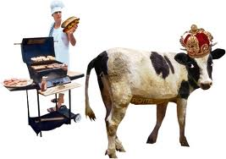
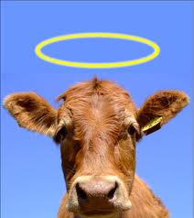
Sacred Cow
Refers to something that cannot be interfered with or harmed in any way.
In Hinduism, cows are considered to be sacred; thus cows are not to be harmed, and certainly not killed for food.

Slide 6
Pearls Before Swine
To “cast one’s pearls before swine” is to offer something precious to someone, or a group of people, unable to appreciate the value of what they are being given.
In the Sermon on the Mount, Jesus admonished his followers to “cast not your pearls before swine.” That is, his followers were to deliver their message to those who would appreciate it, not to those incapable of appreciating something of value. Swine, or pigs, would be unable to appreciate pearls if the jewels were given to them.
Example:
When he makes a profound point that
we students just do not understand, our teacher
sometimes shakes his head and mutters, “Pearls before swine.”

Slide 7
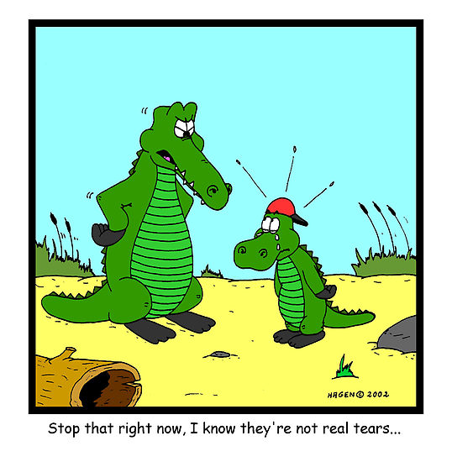
Crocodile Tears
To shed crocodile tears is to show false sympathy
for someone.
Crocodiles were once thought to shed large tears before devouring their prey. This belief comes from the fact that crocodiles have small ducts in the corner of their eyes which release “tears” when the crocodile opens its jaws wide. Obviously, a cold-blooded reptile has no real feelings of sympathy for its prey.
Example:
The villain in the play shed crocodile tears for the hero, but the audience knew that the hero’s downfall was directly caused by the villain’s trickery.

Slide 8
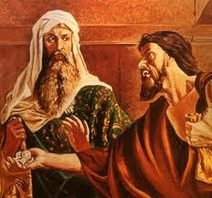
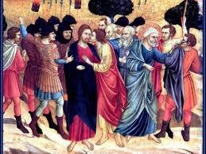
Thirty Pieces of Silver/Betrayed with A kiss
“Thirty pieces of silver” refers to payment received for an act of treachery. “Betrayed with a kiss” refers to a supposed friend’s treachery.
In the Bible, Judas Iscariot was the disciple who agreed to betray Jesus to the authorities in exchange for payment. The thirty pieces of silver were the price of Judas’ betrayal. The way Judas identified Jesus for the authorities was to approach Jesus and greet him with a kiss of identification.
Example:
Patrick Henry warned his
listeners about the supposed
friendliness of the British.
He warned, “suffer not
yourselves to be betrayed
with a kiss.”

Slide 9
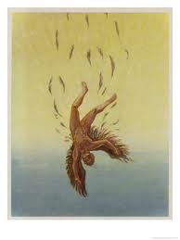
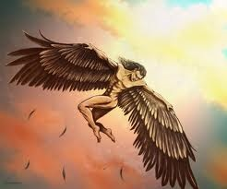
Icarus/Fly Too Close to the Sun
To be “an Icarus” or to “fly too close to the sun” is to fail or be destroyed because of lack of caution or excessive ambition.
In Greek mythology, Icarus and his father, Daedalus, escaped from the island of Crete, by means of wings constructed by Daedalus. The winds were held on by means of wax, and although Daedlus had warned Icarus not to fly too close to the sun, Icarus did not heed the warning; the wax melted, and he fell to his death in the Aegean Sea.
Example:
When I told my roommate I thought I could attend the
all-night party and still do well on
my final exams the next day,
he said, “I have just one word
for you—Icarus.”

Slide 10
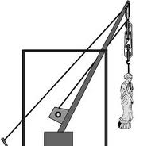
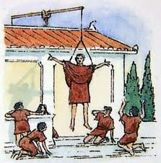
Deus ex Machina
Any surprising turn on events that suddenly make things turn out all right, especially in a literary work. This device is often considered to be an unsatisfying and overly convenient way to end a story.
This phrase literally means “god from the machine.” In classical theater, the machine was a crane with a harness for an actor. The actor could thus be lowered from the ceiling and appear to be flying. In many classical plays, a god would unexpectedly appear, flying to earth to solve a seemingly hopeless problem or save the hero or heroine.
Example:
Many readers feel cheated when writers save their hero or heroine
at the last moment with the common deus ex machina in which
the characters awakens and realizes it was all “only a dream.”

Slide 11
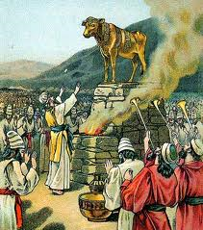
Golden Calf
A “golden calf” is an idol or any object, especially a material object, that is worshipped even though it is not worthy of worship.
In the book of Exodus, Moses is leading his people out of Egypt to the Promised Land. While Moses is up on Mt. Sinai receiving the ten commandments from God, the people melt down their jewelry and ornaments and make a calf out of the gold, and they begin to worship this calf. Moses is angered when he returns to see the people worshipping an idol, and he breaks the stone tablets on which the commandments were written
Example:
For Richard, the car he wanted became a golden
calf. He thought of little else but possessing such
a beautiful automobile.

Slide 12
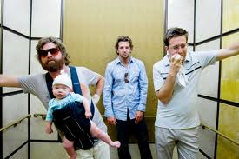
In Medias Res
The phrase can refer to anything that begins
abruptly, in the middle of the action, or it can
be used in its literal sense: into the middle of
things.
This is a Latin phrase, which literally means “into the middle of things.” One of the standard epic conventions is that the epic begins in the middle of the action. Events that occurred earlier are described later in the epic.
Example: The Hangover begins in medias res in Los Angeles with a bride, Tracy, receiving a phone call from Phil who tells her that he and the other groomsmen cannot find the groom, Doug.

Slide 13
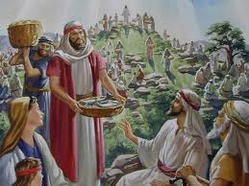
Loaves and Fishes
“Loaves and fishes” refers to an almost miraculous abundance in the face of seeming scarcity.
In several of the gospels, the story is told of
Jesus preaching to a crowd of thousands.
When the people became hungry, all the food
to be found was five loaves and two fish.
Jesus had these brought to him and blessed
the food. His disciples distributed bread and fish to the entire crowd, and there was still food left over.
Example:
When I think back to my struggling student days with my extremely tight budget, I realize that the fact that I didn’t starve is a real case of loaves and fishes.

Slide 14
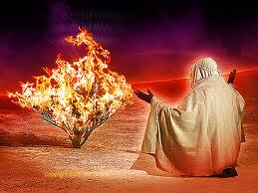
Burning Bush
A “burning bush” refers to a medium through which the voice of absolute authority speaks.
In the book of Exodus, God speaks to Moses from a miraculous burning bush, a bush that burns but is not consumed. He commands Moses to confront Pharoah and demand that Pharoah free the Israelites, and he tells Moses to lead the people to the Promised Land.
Example:
When it comes to investing my money,
I consider him to be the burning bush.
Everything he has ever advised me to do
has paid off beyond my wildest dreams.

Slide 15
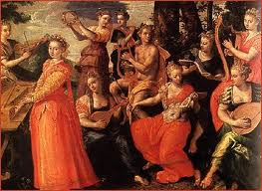
The Muses
Today, a “muse” is someone’s source of inspiration, especially in artistic, creative endeavors.
In Greek mythology, the Muses were nine goddesses who presided over the arts. They gave inspiration to mortals. Typically, an epic begins with an invocation to the Muse, in which the poet asks the Muses to inspire him as he write or sings his story.
Example:
It is common for fashion
Designers to select a particular
woman as a Muse, keeping her
in mind as he or she designs a
new line of clothing.

Slide 16
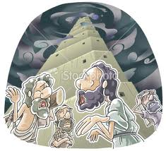
Tower of Babel
Can refer to any noisy confusion. This confusion may or may not be caused by the presence of different languages.
According to the Book of Genesis, Noah’s descendants decided to build a tower that would reach Heaven itself. Concerned that mankind was becoming too powerful, God decided to introduce different languages so that the people could not understand each other and thus could not complete the tower.
Example:
When the delegates from all the different nations
arrived for the conference, the lobby sounded
like the original Tower of Babel.

Slide 17
The Handwriting on the Wall
Refers to an indication that doom or misfortune is coming.
According to the Book of Daniel, Belshazzar, the King of Babylon, gave a great banquet, at which the guests praised the gods of silver, gold, bronze, wood, iron, and stone. Suddenly, a human hand appeared and wrote mysterious words on the wall. Daniel translated the writing, saying it prophesied that Belshazzar’s reign was over. That night, the king was killed.
Example:
I took my boss’s suggestion that I might
want to start updating my resume to be
the handwriting on the wall; I knew it wouldn’t be long until my job, like many others in our company, would be cut.

Slide 18
Pharisees/Pharisaical
A “pharisee” is a hypocrite who upholds the letter of the law, but not its spirit. The adjective “Pharisaical” refers to a hypocritical act.
The Pharisees were a Jewish sect that insisted on strict adherence to written law. Jesus rebuked the Pharisees often for being outwardly pious but inwardly corrupt, only observing the law to impress others, but having no true mercy or love for others.
Example:
If seemed the actor’s commitment
to charitable causes was somewhat
Pharisaical because he would not
attend an event unless he was
assured media would be there.

Slide 19
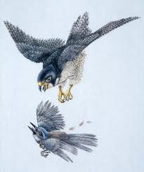
Nemesis
A person’s “nemesis” is that which causes his or her downfall, or the term can refer to the downfall itself.
Nemesis was he Greek goddess of vengeance and retribution. She punished people for wrongdoing, especially for excessive pride.
Example:
The cyclist considered that particular
stretch of mountain to be his nemesis,
costing him a racing victory year after year

Slide 20
Delphic Oracle
A “Delphic” prediction or message is one that is ambiguous and difficult to interpret.
In ancient Greece, Delphi was the location of the Temple of Apollo. People came to this temple, the site of Greece’s most famous oracle, with all kinds of questions, and Apollo’s priestess would go into a trance and deliver the answers. These answers were difficult to interpret and riddle-like.
Example:
Lorraine had a flair for the dramatic; she liked to anounce puzzling
but shocking predictions as if she were the Oracle at Delphi.

Slide 21
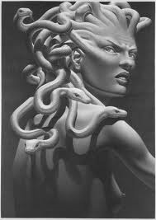
Medusa
Refers to a repulsive or terrifying woman. The term is also applied to extraordinarily wild, unruly hair.
The most famous of the gorgons, three sisters in Greek mythology who had snakes for hair and who turned anyone who looked at them to stone.
Example:
After being caught in a rainstorm, I looked in
the mirror and was horrified to see Medusa
staring back at me.

Slide 22
Philistines/Philistinism
In modern usage, “philistine” refers to a person with no appreciation for culture and whose tastes are commonplace.
In the Old Testament, the Philistines were enemies of the Israelites. In a famous biblical story, David successfully fought the giant Philistine warrior, Goliath.
Example:
The artist was appalled at the philistinism of
those attending his gallery show; rather than
appreciating his work, many of them seemed
most concerned about whether a particular
painting would match their sofa.

Slide 23
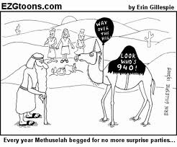
Methuselah
Has come to be used proverbially to refer to an extremely old person.
Methuselah is the oldest of the patriarchs in the Bible. He lived to be 969 years old.
Example:
If I live to be as old as Methuselah, I will never understand how that horrible film was nominated for an Academy Award.

Slide 24
Scylla and Charybdis
“Between Scylla and Charybdis” means to be caught between two equal dangers in which avoiding one means getting closer to the other. The phrase has the same meaning as “between a rock and hard place.”
In Greek mythology, Scylla was a many-headed sea monster, living in a cave on one side of a narrow strait. Charybdis was a whirlpool on the opposite side of the strait. Sailors, including Odysseus and Jason, had to steer their ships very carefully between the two in order to avoid being a victim of one or the other.
Example:
Caught between the Scylla of raising taxes
and angering voters and the Charybdis of
cutting vital city services, the council knew their decision was not going to be an easy one.

Slide 25
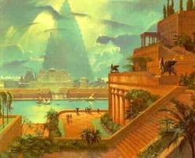
Babylon
Refers to a place of decadence and corruption.
Babylon was the capital of the ancient Babylonian Empire. The city was known for its luxury and corruption. The Jews were exiled there from 597 to 538 B.C. and the prophet Daniel became counselor to the King of Babylon, for whom he interpreted “the handwriting on the wall.” Eventually the Jews were allowed to return to Israel.
Example:
I tried to reassure my parents that I was
only going off to a university, not to
Babylon, but they seemed to think the two
were synonymous.

Slide 26
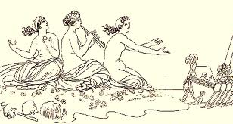
Sirens
In modern usage, “sirens” can refer to anything that tempts a person away from safety and toward a destructive path. A “siren song” is the temptation used to lure a person.
In Greek mythology, sirens were sea creatures who lured sailors to their deaths on the rocky shores by singing a beautiful, irresistible song. They are usually depicted as women,
or as half-women, half bird.
Example:
I had intended to stay home and study for
finals, but the siren song of my friends describing the fun we would have at the lake was too much for me to resist.

